Slide 1

An introduction to Web Apollo. A webinar for the i5K Pilot Species Projects
UNIVERSITY OF
CALIFORNIA
Monica Munoz-Torres, PhD
Biocurator & Bioinformatics Analyst | @monimunozto
Genomics Division, Lawrence Berkeley National Laboratory
04 February, 2014

Slide 2
Outline
What is Web Apollo?:
Definition & working concept.
Community based curation from our experience:
Lessons Learned.
Becoming acquainted with Web Apollo.
An introduction to Web Apollo. A webinar for the i5K Pilot Species Projects.

Slide 3
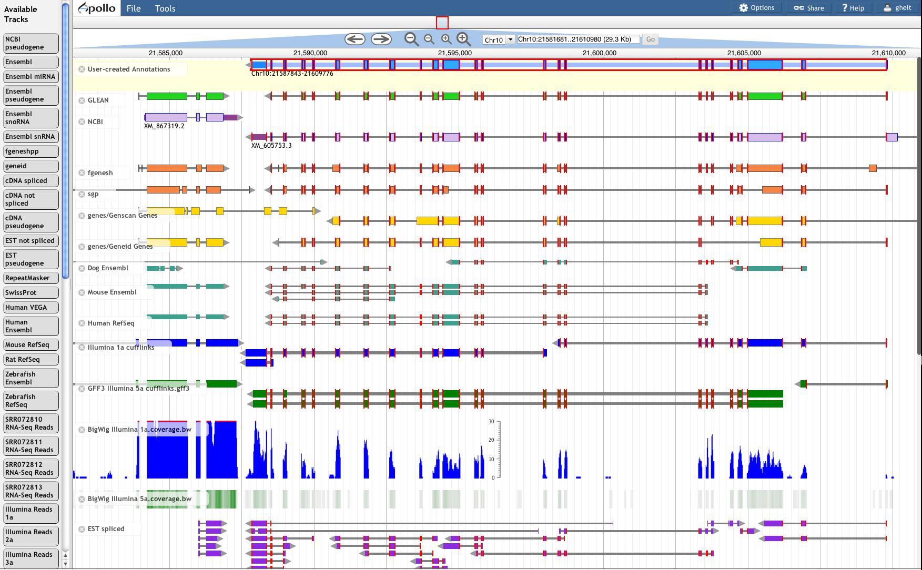

What is Web Apollo?
Web Apollo is a web-based genomic annotation editing platform.
We need annotation editing tools to modify and refine the precise location and structure of the genome elements that predictive algorithms cannot yet resolve automatically.
Find more about Web Apollo at http://GenomeArchitect.org and Genome Biol 14:R93. (2013).

Slide 4

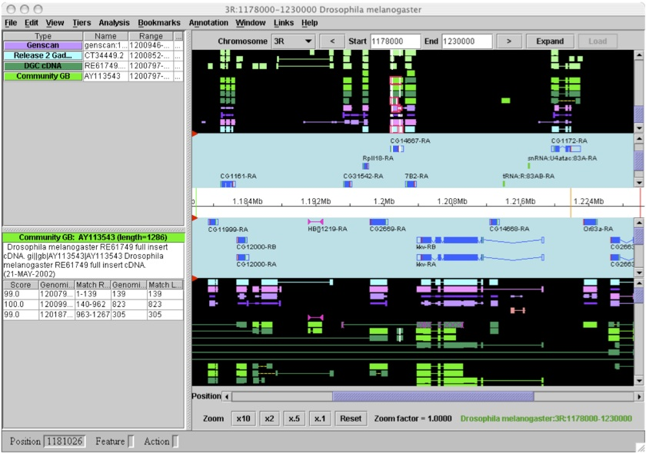
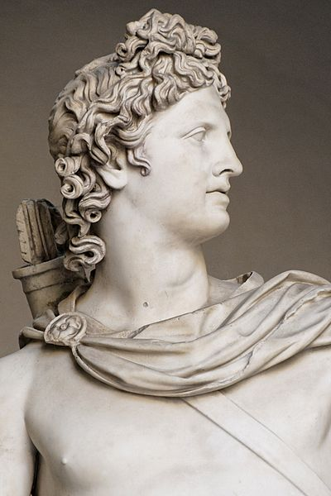
Brief history of Apollo*:
Biologists could finally visualize computational analyses and experimental evidence from genomic features and build manually-curated consensus gene structures. Apollo became a very popular, open source tool (insects, fish, mammals, birds, etc.).
a. Desktop: one person at a time editing a specific region, annotations saved in local files; slowed down collaboration.
b. Java Web Start: users saved annotations directly to a centralized database; potential issues with stale annotation data remained.
*

Slide 5
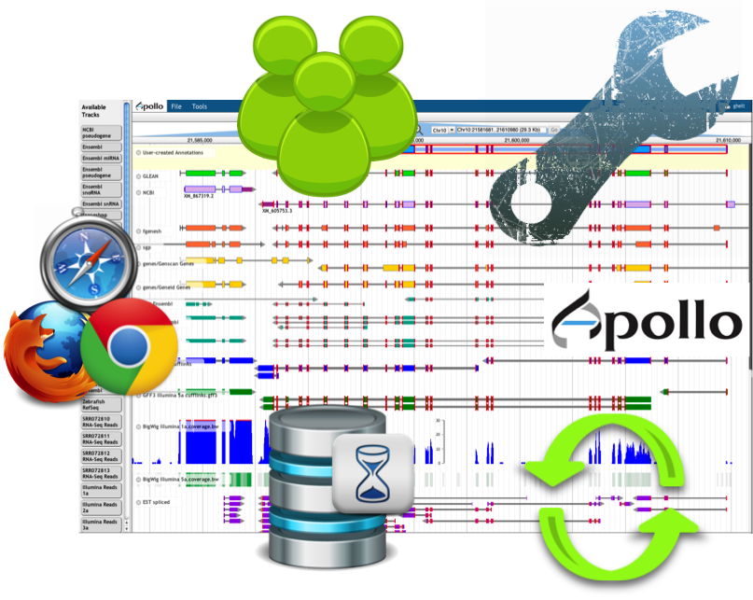
Web Apollo
Browser-based; plugin for JBrowse.
Allows for intuitive annotation creation and editing, with gestures and pull-down menus to create transcripts, add/delete/resize exons, merge/split exons or transcripts, insert comments (CV, freeform text), etc.
Customizable rules and appearance.
Edits in one client are instantly pushed to all other clients.

Slide 6
Our Working Concept
In the context of gene manual annotation, curation tries to find the best examples and/or eliminate (most) errors.
To conduct manual annotation efforts:
Gather and evaluate all available evidence using quality-control metrics to corroborate or modify automated annotation predictions.
Perform sequence similarity searches (phylogenetic framework) and use literature and public databases to:
Predict functional assignments from experimental data.
Distinguish orthologs from paralogs, and classify gene membership in families and networks.
Automated gene models
Evidence:
cDNAs, HMM domain searches, alignments with assemblies or genes from other species.
Manual annotation & curation

Slide 7


Dispersed, community-based gene manual annotation efforts.
Using Web Apollo, we* have trained geographically dispersed scientific communities to perform biologically supported manual annotations, and monitored their findings: ~80 institutions, 14 countries, hundreds of scientists, and gate keepers.
Training workshops and geneborees.
Tutorials with detailed instructions.
Personalized user support.
*Collaboration with Elsik Lab, Hymenoptera Genome Database.

Slide 8
What have we learned?
Harvesting expertise from dispersed researchers who assigned functions to predicted and curated peptides, we have developed more interactive and responsive tools, as well as better visualization, editing, and analysis capabilities.
Assessment:
Was it helpful / productive to work together?
Were manual annotations improved?
Did the shared and distributed annotation effort help improve the quality of scientific findings?

Slide 9
It is helpful to work together.
Scientific community efforts bring together domain-specific and natural history expertise that would have otherwise remain disconnected.

Slide 10
Improved Automated Annotations*
In many cases, automated annotations have been improved.
Also, learned of the challenges of newer sequencing technologies, e.g.:
Frameshifts and indel errors
Split genes across scaffolds
Highly repetitive sequences
To face these challenges, we train annotators in recovering coding sequences in agreement with all available biological evidence.

Slide 11
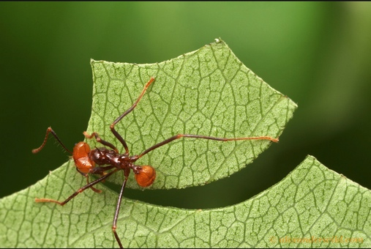
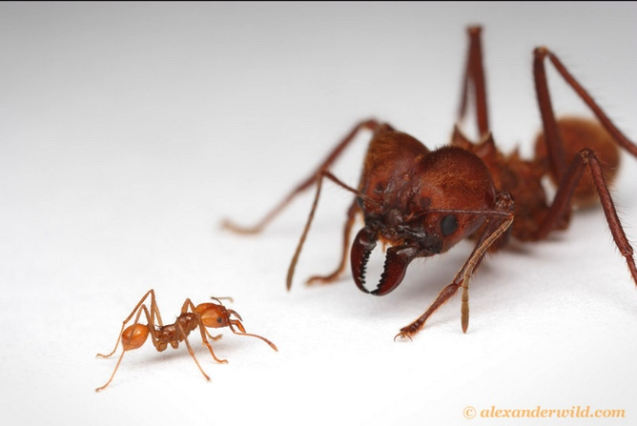
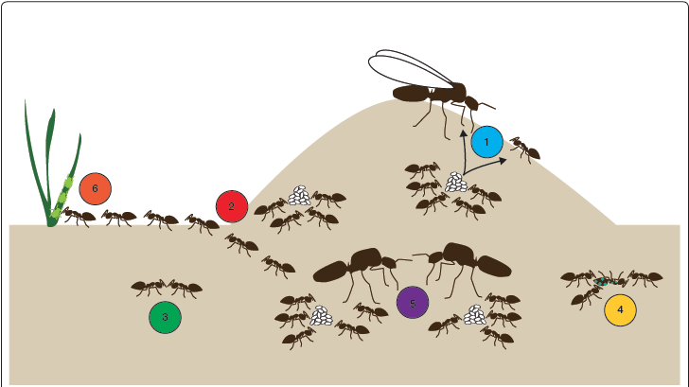
… groups of communities have taught us a lot!
Understanding the evolution of sociality.
Comparison of the genomes of 7 species of ants contributed to a better understanding of the evolution and organization of insect societies at the molecular level.
Insights drawn mainly from six core aspects of ant biology:
Alternative morphological castes
Division of labor
Chemical Communication
Alternative social organization
Social immunity
Mutualism
Libbrecht et al. 2012. Genome Biology 2013, 14:212

Slide 12
A little training goes a long way!
With the right tools, wet lab scientists make exceptional curators who can easily learn to maximize the generation of accurate, biologically supported gene models.

Slide 13
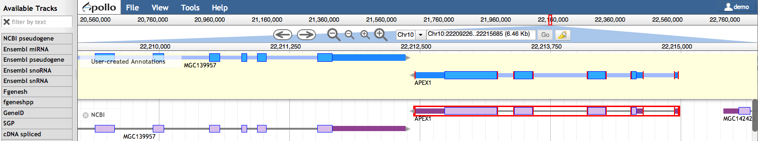

Web Apollo
‘File’: Upload your own evidence: GFF3, BAM, BigWig, VCF*. Add combination and sequence search tracks.
‘Tools’: Use BLAT to query the genome with a protein or DNA sequence.
‘View’: change color by CDS, toggle strands, set highlight.
Grey bar of coordinates indicates location. You can also select here in order to zoom to a sub-region.
Navigation tools: pan and zoom
Search box: go to a scaffold or a gene model.
‘User-created Annotations’ Track
Evidence Tracks Area
Available Tracks
Login
Graphical User Interface (GUI) for editing annotations
Notes:
File: GFF3, BAM, BigWig, VCF (soon).
Tools: The plug-in architecture of the annotation editing engine allows for sequence alignment searches using BLAT

Slide 14
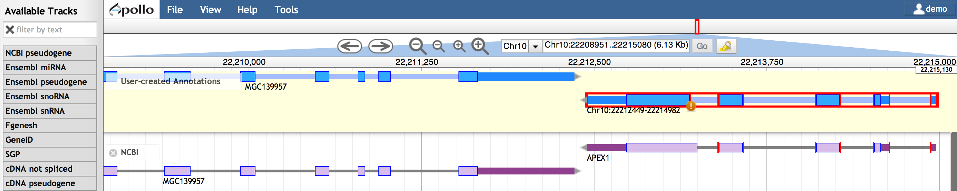
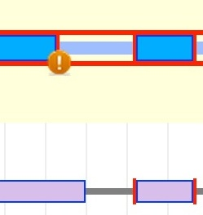
Web Apollo
The editing logic is on the server:
selects longest ORF as CDS
flags non-canonical splice sites
‘User-created Annotations’ Track
Evidence Tracks Area
Flags non-canonical splice sites.
Selection of features and sub-features
Edge-matching
Notes:
The editing logic is on the server:
It selects the longest ORF as CDS
And flags non-canonical splice sites
The server is a Java servlet
- it uses the GMOD biological object layer (gbol) data model: object model & API, based on the Chado schema

Slide 15
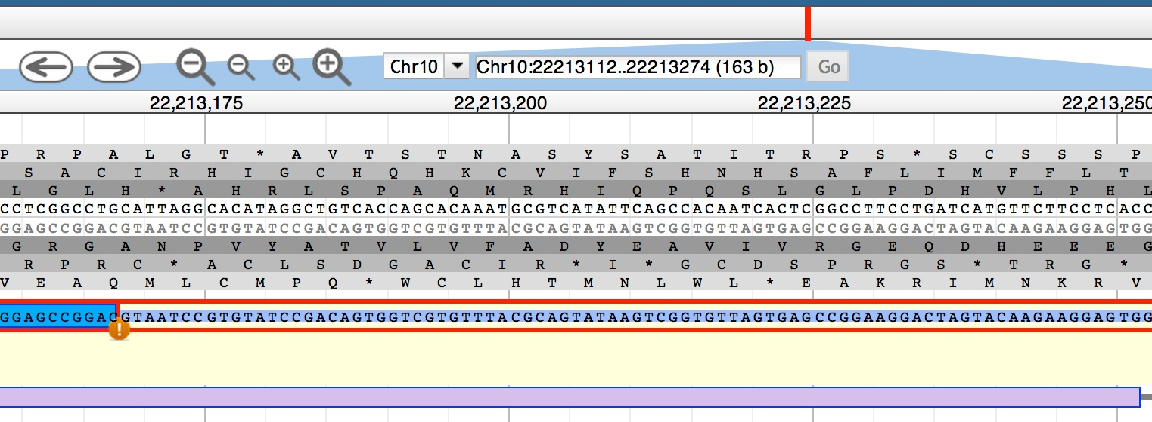
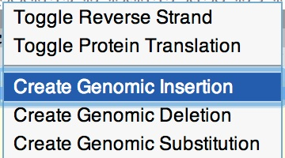
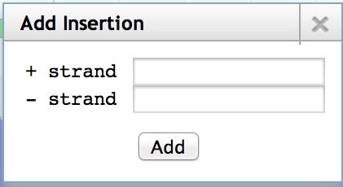
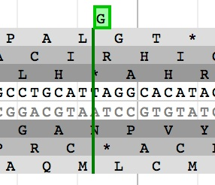
Web Apollo
Two new kinds of tracks:
annotation editing
sequence alteration editing
DNA Track
‘User-created Annotations’ Track

Slide 16
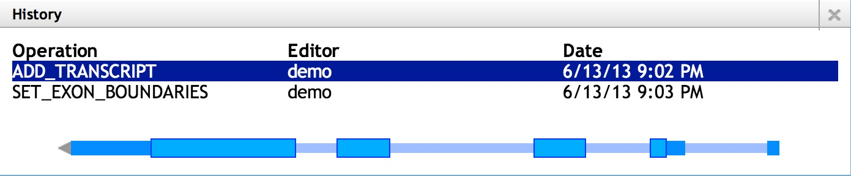
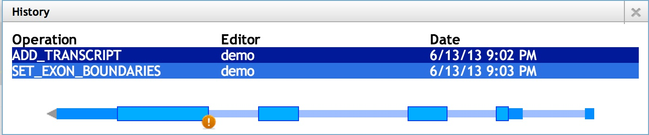
Web Apollo
Annotations, annotation edits, and History: stored in a centralized database.
Notes:
A BerkeleyDB stores annotations, annotation edits, and their History

Slide 17
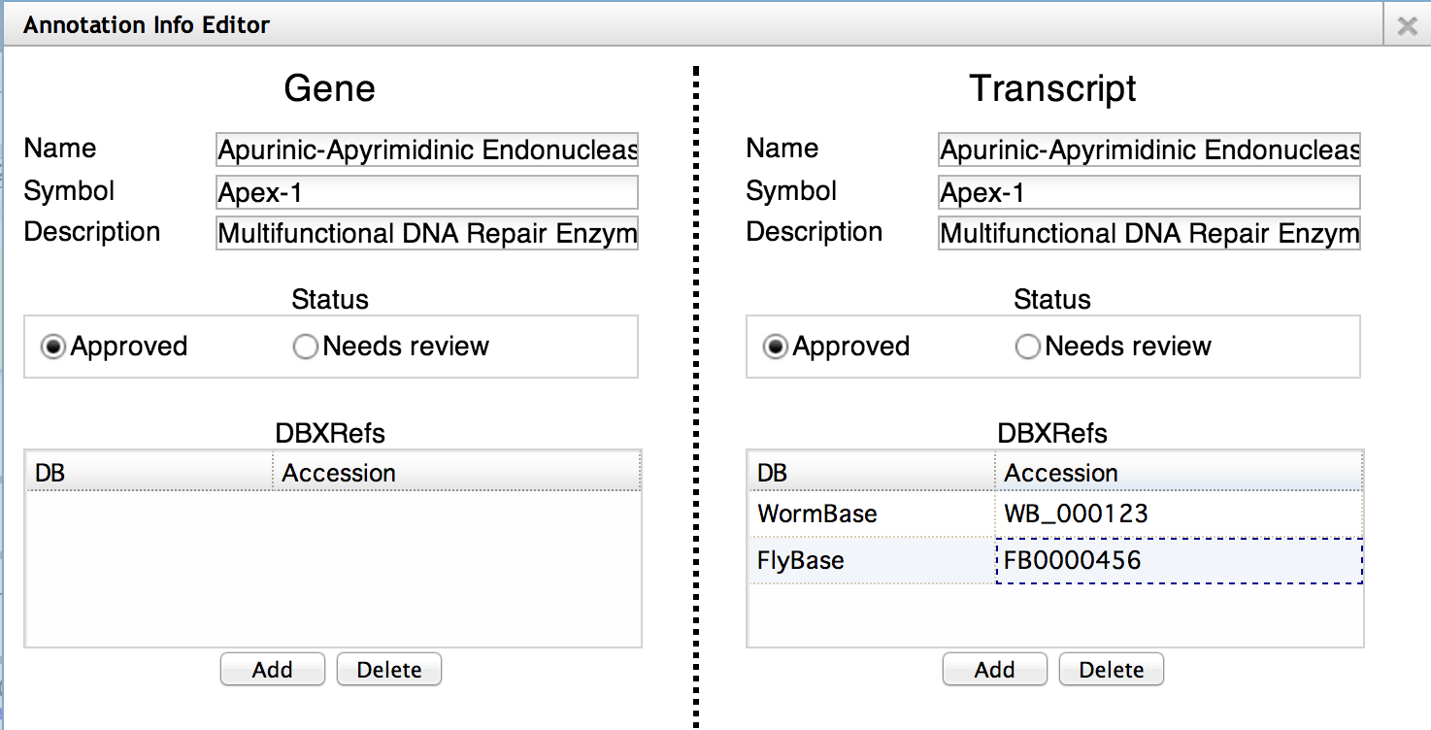
Web Apollo
Annotation Information Editor

Slide 18
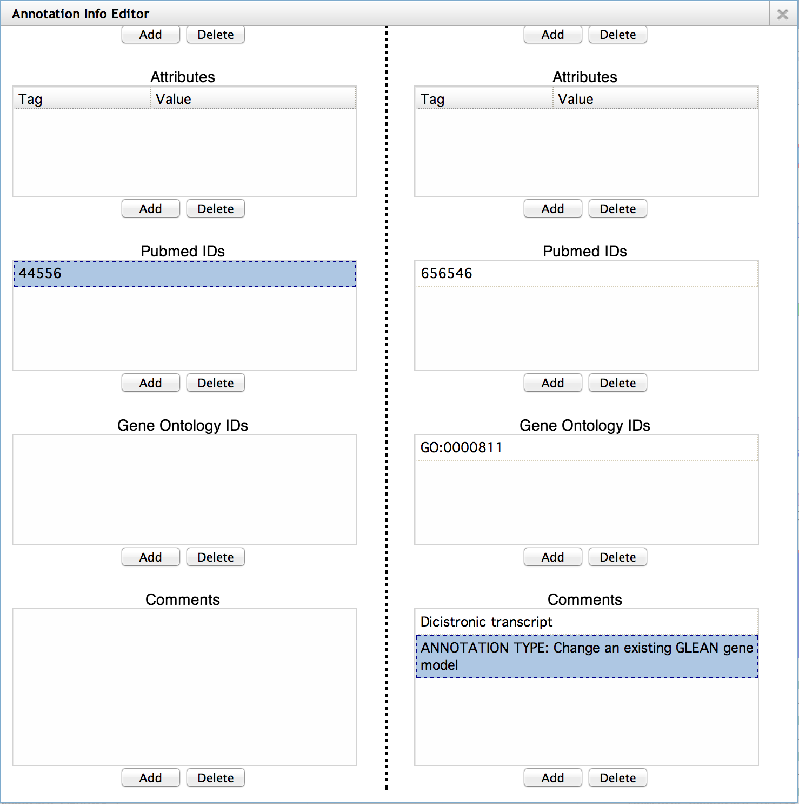
Web Apollo
Annotation Information Editor

Slide 19
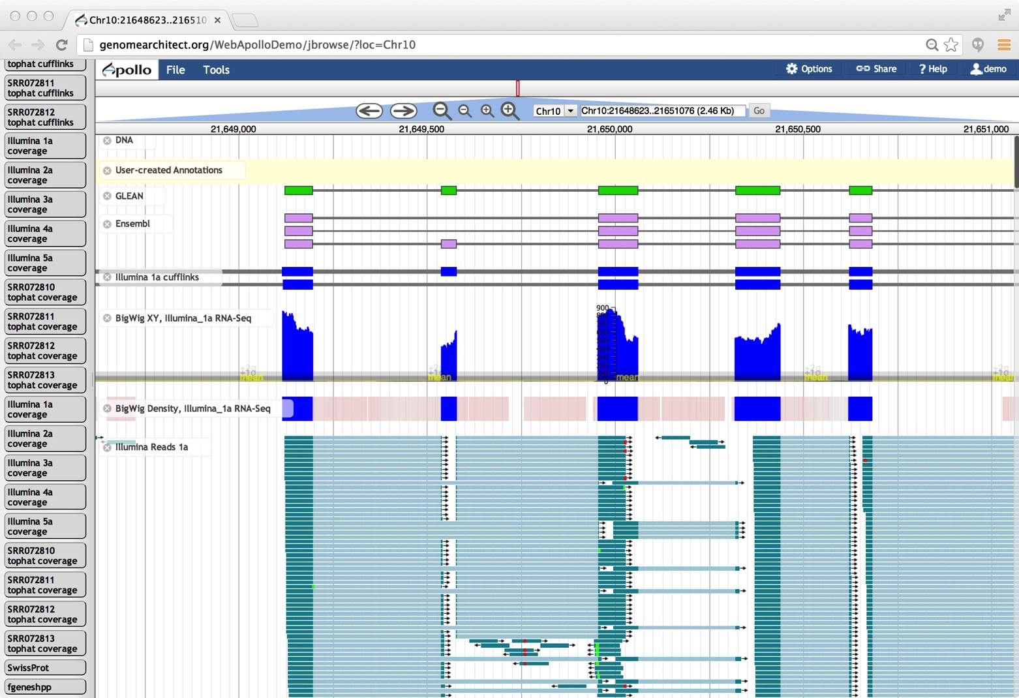
[Some of the] Functionality:
Protein-coding gene annotation (that you know and love)
Sequence alterations (less coverage = more fragmentation)
Visualization of stage and cell-type specific transcription data as coverage plots, heat maps, and alignments

Slide 20

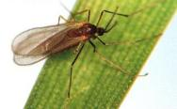
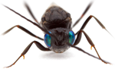
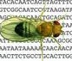
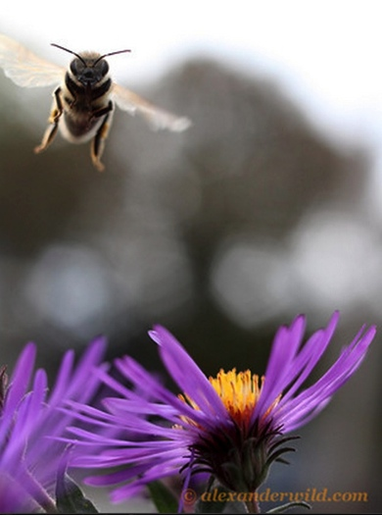
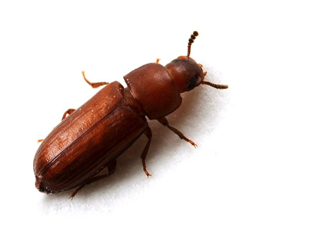
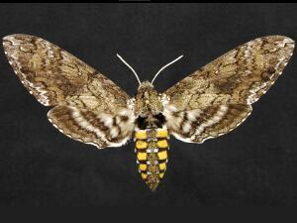
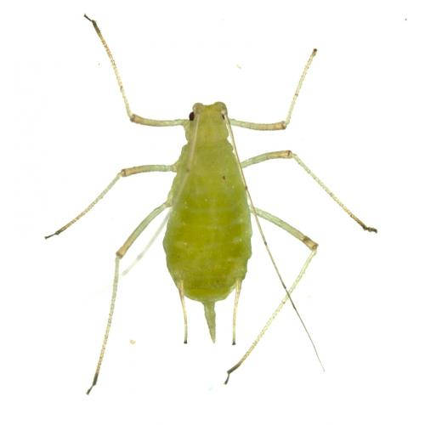
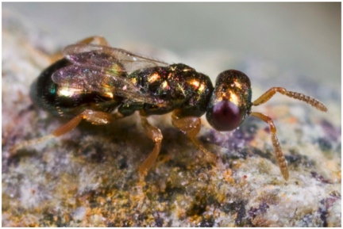
Arthropodcentric Thanks!
AgriPest Base
FlyBase
Hymenoptera Genome Database
VectorBase
Apis mellifera
Tribolium castaneum
Pogonomyrmex barbatus
Manduca sexta
Bombus terrestris
Helicoverpa armigera
Nasonia vitripennis
Acyrthosiphon pisum
Mayetiola destructor
Atta cephalotes
Linepithema humile
Camponotus floridanus
Solenopsis invicta
Acromyrmex echinatior

Slide 21
Thanks!
Berkeley Bioinformatics Open-source Projects (BBOP), Berkeley Lab: Web Apollo and Gene Ontology teams. Suzanna Lewis (PI).
Ian Holmes Lab (PI). *U. of California Berkeley.
The team at Hymenoptera Genome Database. §U. of Missouri. Christine G. Elsik (PI).
Arthropod genomics community (fringy Richards, Monica Poelchau, Alexie Papanicolaou, Gene Robinson, Juergen Gadau, Chris R Smith, Owen McMillan, Owain Edwards, Kevin Hackett, and a few hundred more).
i5K Steering Committee, NAL (USDA), HGSC-BCM, BGI, 1KITE.
Web Apollo is supported by NIH grants 5R01GM080203 from NIGMS, and 5R01HG004483 from NHGRI, and by the Director, Office of Science, Office of Basic Energy Sciences, of the U.S. Department of Energy under Contract No. DE-AC02-05CH11231.
Images used with permission: AlexanderWild.com
For your attention, thank you!
BBOP
Web Apollo
Gregg Helt
Ed Lee
Rob Buels *
Mitch Skinner *
Justin Reese §
Chris Childers §
Gene Ontology
Chris Mungall
Seth Carbon
Heiko Dietze
Web Apollo: http://GenomeArchitect.org
GO: http://GeneOntology.org
i5K: http://arthropodgenomes.org/wiki/i5K

